Slide 1
Faculty Senate
March 23, 2017
Dr. Robert J. Marley
Provost and Executive Vice Chancellor for Academic Affairs

Slide 2
Search Update
CEC Vice Provost and Dean: ongoing, nearing 1st round interview stage
Biological Sciences Chair: Dr. David Duvernell of SIUE to begin August 1st.
Computer Science: finalists are now visiting campus
GGPE: second phase of solicitations with the assistance of a recruiting firm
EMSE: internal search has been approved
Psychological Science: internal search has been approved.
Library Director: posted
CIO: deferred to FY2018
Enrollment Management: will begin in FY2018

Slide 3
Budget Update
Visits to units to solicit input have been taking place and are ongoing
Awards
Please see unit updates
Note receipt of third NSF Career Award
Caizhi Zhou - MSE
Jie Gao - MAE
Edward Kinzel - MAE

Slide 4
QUESTIONS?

Slide 5
Division Updates
Faculty Senate Meeting
Thursday, March 23, 2017

Slide 6
Enrollment Management
Thanks to all who helped with February Out of State Counselor Fly In Program
FIRST Robotics Competition on March 4 was very successful – over 550 high school team members and over 1400 in total attendance
Saturday, April 8 is the next PRO Date. All PRO Days are filled until June dates.
Friday, April 14 is the next Open House
New undergraduate student projections show 1,425 – 1,450 new freshmen and 415 new transfer students. This is about a 3% decrease from last year.

Slide 7
College of Arts, Sciences, and Business
Dave Westenberg (Biological Sciences) will receive the 2017 Science Educator Award from Academy of Science – St. Louis. Westenberg will be honored at the 23rd Annual Outstanding St. Louis Scientists Award dinner.
First Year Research Experience (FYRE) Pilot Program pairs faculty mentors with first year students in an apprentice-style research partnership. Faculty mentors receive $500 in professional development funds and students receive $500 stipends.
Faculty mentors:
Jessica Cundiff (Psychological Science)
Amber Henslee (Psychological Science)
Sarah Hercula (English and Technical Communication)
Yew San Hor (Physics)
Yinfa Ma (Chemistry)
Terry Robertson (Arts, Languages, and Philosophy)
Rachel Schneider (English and Technical Communication)
Jeanne Stanley (Arts, Languages, and Philosophy)
Matt Thimgan (Biological Sciences)

Slide 8
College of Arts, Sciences, and Business
Thomas Vojta (Physics) has been awarded an additional $110,000 by NSF for his project entitled, “Unconventional quantum phase” to bring the total award to $339,000.
Dev Niyogi (Biological Sciences) has been awarded an additional $6,673 by USDA, Forest Service, Mark Twain National Forest for his project entitled, “Mill Creek watershed assessment” to bring the total award to $127,114.
Honglan Shi (Chemistry) has been awarded $30,991 by Nanova Environmental, Inc. for her project entitled, “Beta testing of a newly developed NovaTest P10 portable 2D GC.”
Trent Brown (English and Technical Communication) was quoted in the Christian Science Monitor regarding a recent appeals court decision allowing removal of confederate monuments in New Orleans.

Slide 9
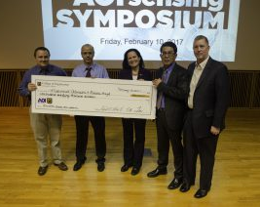
College of Engineering and Computing
Drs. Joe Stanley (ECE), Hank Pernicka (MAE), Scott Miller (MSE) and Theresa Swift (ECE) were named the inaugural group of CEC Dean’s Educator Scholars
Prof. Xiaoping Du became Fellow of ASME (American Society of Mechanical Engineering)
Dr. Edward Kinzel received an NSF CAREER Award (third in CEC this year!)
Dr. Edward Kinzel was also the recipient of seed money from symposium with whitepaper titled “Manufacturing Low Cost Plasmonic Sensors for Chemical and Biological Sensing”
Steve Watkins was elected to be the future president of IEEE-HKN, the ECE honor society
Dr. Jun Fan, professor of electrical and computer engineering at Missouri S&T, is using a Google grant to provide real-world solutions by deciphering and solving the problems of electromagnetic interference inherent in the systems.
Dr. Braden Lusk, chair and professor of mining and nuclear engineering, was recently named to the National Academy of Sciences, Engineering and Medicine’s Committee on Surface Coal and Human Health.
 | Ed Kinzel receiving AOI seed money for collaboration with Dr. Mahoud Almasri, Electrical Engineering and Computer Science Associate Professor at Mizzou

Slide 10
College of Engineering and Computing
Dr. Mohsen Asle Zaeem, assistant professor of materials science and engineering, has been named the Young Leaders International Scholar by The Minerals, Metals and Materials Society (TMS) and the Federation of European Materials Societies (FEMS). TMS is a professional society that connects minerals, metals and materials scientists and engineers who work in industry, academia and government positions around the world.
Dr. Simone Silvestri, Assistant Professor of Computer Science, in collaboration with Dr. Denise Baker, Assistant Professor of Psychology, received a grant of $802,981 from the National Institute of Food and Agriculture for the project "Integration of Social Behavioral Modeling for Smart Environments to Improve Energy Efficiency of Smart Cities." The period of performance is Feb 15, 2017 to Feb 14, 2020.
Dr. Genda Chen was a guest speaker at the 2017 Missouri Transportation Conference held on Feb. 16 in Jefferson City. Chen is the Robert W. Abbett Distinguished Chair in Civil Engineering at Missouri S&T and director of a new University Transportation Center. In his presentation, “Inspecting and Preserving Infrastructure through Robotic Exploration (INSPIRE),” he spoke about the center’s vision, upcoming research and innovative workforce training.
Dr. Donald Wunsch, the Mary F. Finley Missouri Distinguished Professor of Computer Engineering, presented “No-boundary Thinking in Big Data” at Beijing University of Science and Technology Feb. 24. Wunsch has been involved in long-term collaborations with Beijing S&T and other universities in China. He will lead a conference on no-boundary thinking in bioinformatics at Missouri S&T in April.
Dr. Heng Pan was interviewed for an article, “3D Printing Has Potential to Create Wearable, Stretchable Electronic Devices,” by Laura Panjwani that was published Jan. 18 on the R&D Magazine site. Pan is an assistant professor of mechanical and aerospace engineering. In the article, he discussed stretchable electronics and additive manufacturing.

Slide 11
College of Engineering and Computing
Dr. Sajal K. Das, Chair and Professor of Computer Science and Daniel St. Clair Endowed Chair has been recently selected in the National Science Foundation's Subcommittee on Sustainable Urban Systems (SUS).
Best Student Paper award, Mortada Aman and Egemen K. Çetinkaya (advisor), “Towards Cloud Security Improvement with Encryption Intensity Selection” Design of Reliable Communication Networks, Munich on March 8-10, 2017
S&T’s chapter of HKN – the ECE Honor Society - has won an Outstanding Chapter Award, putting it among the world’s top chapters. That makes 15 years in a row.
Ali Foudazi, Matt Dvorsky, Atieh Talebzadeh, and Micheal Shariff were selected among six finalists of the IEEE APS International Student Design Competition in IEEE APSURSI 2017 in San Diego
Best Student Paper: A. Ghazanfari, W. Li, M. C. Leu, J. Watts, Y. Zhuang, and J. Huang, “Freeform Extrusion Fabrication of Advanced Ceramic Components With Embedded Sapphire Optical Fiber Sensors,” 2016 Conference on Smart Materials, Adaptive Structures and Intelligent Systems (SMASIS 2016) of ASME
IEEE St. Louis Section Awards:
Outstanding Student Member - Katelyn Brinker
Outstanding Student Branch - MS&T
Outstanding Young Engineer - Trevor McCasland
Outstanding Branch Counselor - Amardeep Kaur

Slide 12
Office of Undergraduate Studies
Undergraduate Research Day at the Capitol
April 4th, 2017
10 students assigned to attend from S&T
Undergraduate Research Conference
April 11th
Havener Center
Posters and Presentations

Slide 13
Office of Graduate Studies
Doctoral Student Recruitment Grants - 5 grant proposals received
Track I: Recruitment of highly competitive underrepresented minority doctoral students (African American, Hispanic, Native American, Pacific Islanders) and/or female doctoral students
Track II: General recruitment of highly competitive doctoral students
Chancellor’s Distinguished Fellowship - 24 nominations received and 9 students awarded
Chemical Engineering - 1
Chemistry - 2
Computer Science - 1
Electrical Engineering - 1
Mechanical Engineering - 4
Graduate Fellows Poster Session held on Feb. 27
1st Place: Leiren Jarvis, PhD Ceramic Engineering
2nd Place: George Shannon, PhD Systems Engineering
3rd Place: Gregory Taylor, PhD Aerospace Engineering
Honorable Mention: Michelle Gegel, PhD Mechanical Engineering
Honorable Mention: Jon Hill, MS Environmental Engineering
1 proposal received and awarded | Drs. Joel Burken, Civil, Architectural, and Environmental Engineering and Dr. Kwame Awuah-Offei, Mining and Nuclear Engineering
4 proposals received and awarded | Dr. Chang-Soo Kim, Electrical and Computer Engineering Drs. Wei Jiang and Daniel Tauritz, Computer Science Dr. V.A. Samaranayke, Mathematics and Statistics Dr. Joshua Rovey, Mechanical and Aerospace Engineering

Slide 14
Office of Sponsored Programs
Summary of FY17 activities year-to-date (January)
Number of funded proposals is down by 2% for a total of 162
Total dollars is $18M which is down by 10%
Number of new proposals submitted is up 9% for a total of 347
Total dollars is $88M which is down by 1%
Number of active awards is up by 2% at 603
Total expenditures is $25M which is up by 5%
Net grant and contract expenditures is $18M which is up by 7%
F&A recovered is $3M which is up by 5%

Slide 15
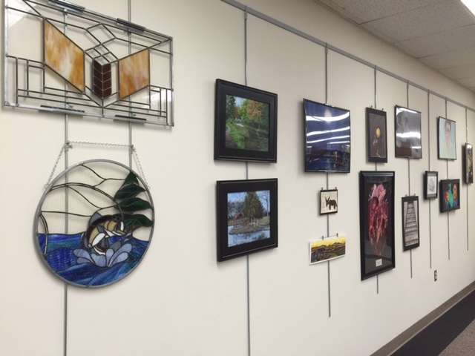
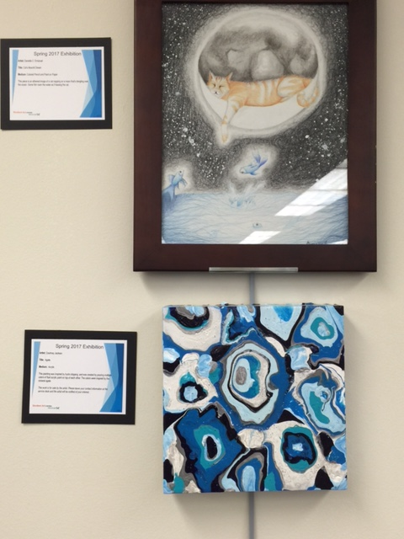
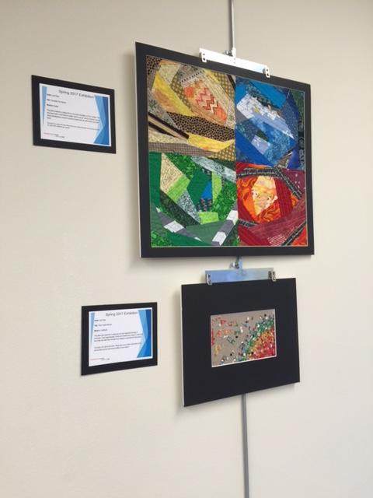
Curtis Laws Wilson Library
Student Art in the Library
2nd floor
Artists’ Reception
April 4, 2017, 4 pm - 5 pm

